Slide 1
Loan Status Prediction
By : Abdallah Elrabeay Gomaa Zyada

Slide 2
Overview
About the dataset
The dataset contain more than 140K records and about 23 feature.
The dataset is enormous and consists of multiple deterministic factors like
barrows income , gender, loan perpose , etc.
The dataset is subject to strong multicollinearity and empty values

Slide 3
Table of contents
01
02
03
Data exploration
Exprolatory data analysis EDA
Data prepossing
04
05
06
Data manipulation
Feature selection and extraction
Predictive modeling and conclusion

Slide 4
01
Data Exploration

Slide 5
After we import the dataset it shows a lot of missing values.
We identify the target and labels variables.

Slide 6
02
Exploratory Data Analysis (EDA)

Slide 7
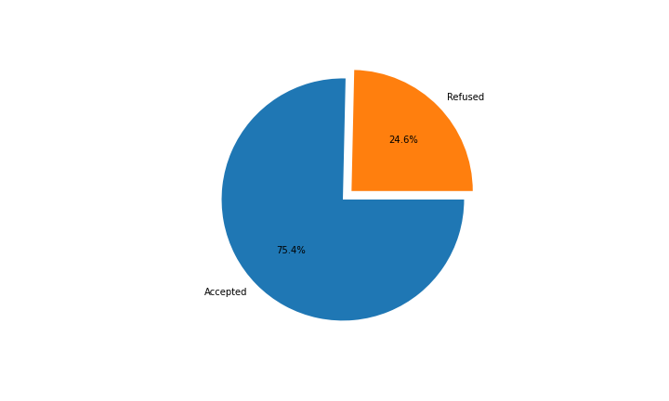
After exploring the data set we find that 24% of the application are refused.
We identify the categorical and numeric features.

Slide 8
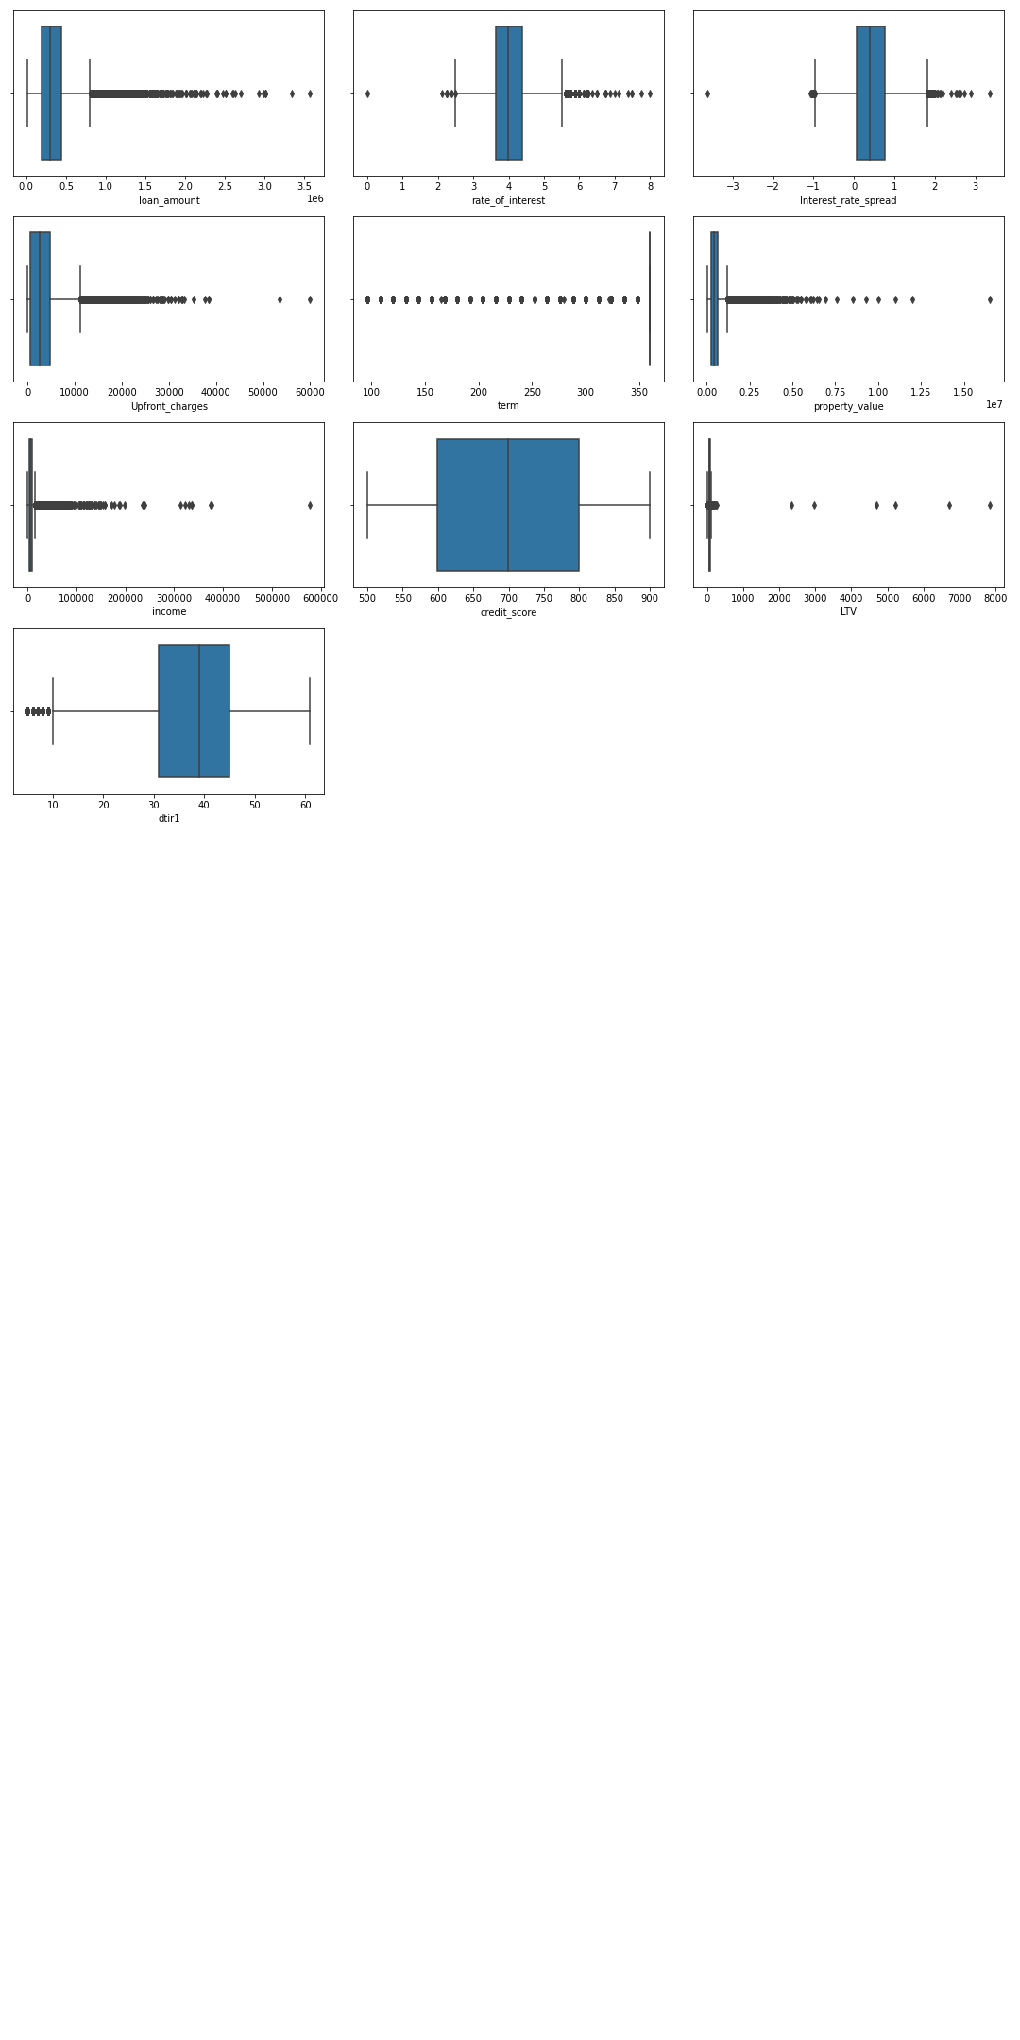
In this plot we detect a lot of outliers.

Slide 9
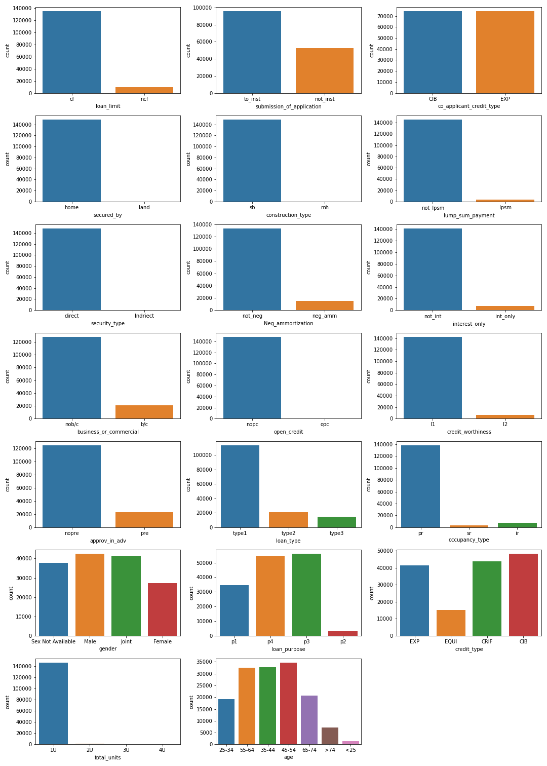
In this plot we see that the data is unbalanced.

Slide 10
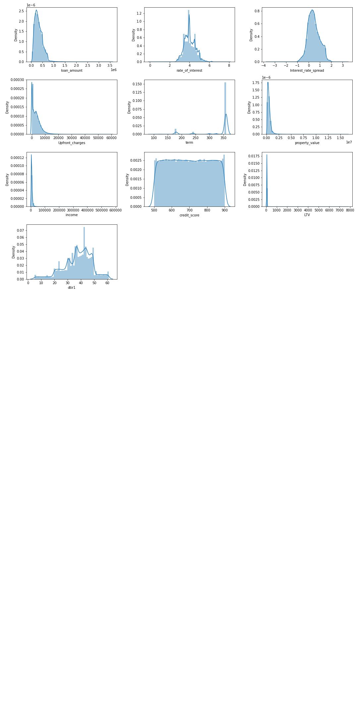

Slide 11
03
Data Preprocessing

Slide 12
We chick for any duplicated data and remove them.
Chick for any empty data and fill them using Simple Imputer.
Convert the categorical columns to numeric.
Detect and Remove any outliers.
Fixing the imbalance using SMOTE Technique.

Slide 13
04
Data Manipulation

Slide 14
Splitting the data intro training & testing sets.
Feature Scaling (Standardization).

Slide 15
05
Feature Selection/ Extraction

Slide 16
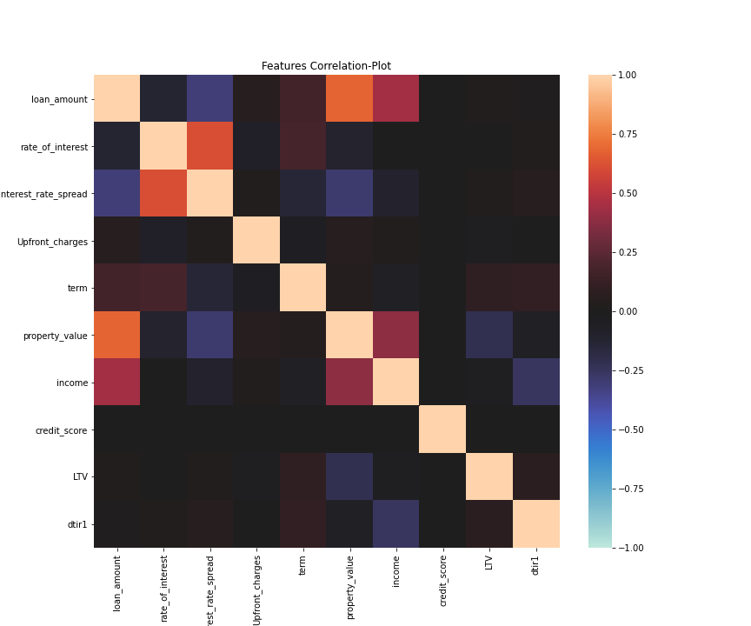
Checking the correlation.
Decomposition Method - Principle Component Analysis (PCA)

Slide 17
06
Predictive modeling and conclusion

Slide 18
We use cross validate to test different models.
The Random Forest Classifier.
We use the Randomized Search CV for Hyper parameter tunning.

Slide 19
Here are some of the key outcomes of the project
The Dataset was large enough summing around 1.5K samples.
The samples were slightly imbalanced after processing, hence SMOTE Technique was applied on the data to balance the classe.

Slide 20
Visualising the distribution of data & their relationships, helped us to get some insights on the relationship between the.
Feature Selection/Eliminination was carried out and appropriate features were shortlisted

Slide 21
Testing multiple algorithms with fine-tuning hyperparamters gave us some understanding on the model performance for various algorithms on this specific dataset.

Slide 22
Thanks!
Do you have any questions?
Please keep this slide for attribution

